Slide 1
Personal Health Care Management System
Group ID - ITP_WD_B07_G06

Slide 2
Group Members
Registration Number | Name
IT21318320 | Silva T.U.D
IT21313684 | Karunarathne D.T.S
IT21319174 | Dissanayake M.G.T.W
IT21319242 | Ilangarathne R.A.C.W
IT21276996 | Fernando W.Y.M
IT21200724 | G.N.Bandara
IT21321504 | Gunawardana N.B.C.A.W
IT21347962 | Siribaddana K.

Slide 3

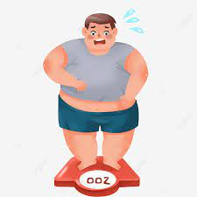
Background
Health Care Sector

Slide 4

Problem
Ordinal method of treating patients
Time Requirements
Motivation
Offers individualized treatment programs
Better Outcomes and improved health

Slide 5

Aim and Objectives
Evaluate the risk level of patients?
– Auto-evaluate risk levels.
Personalize the treatment method?
– Suggest appropriate treatment methods.

Slide 6
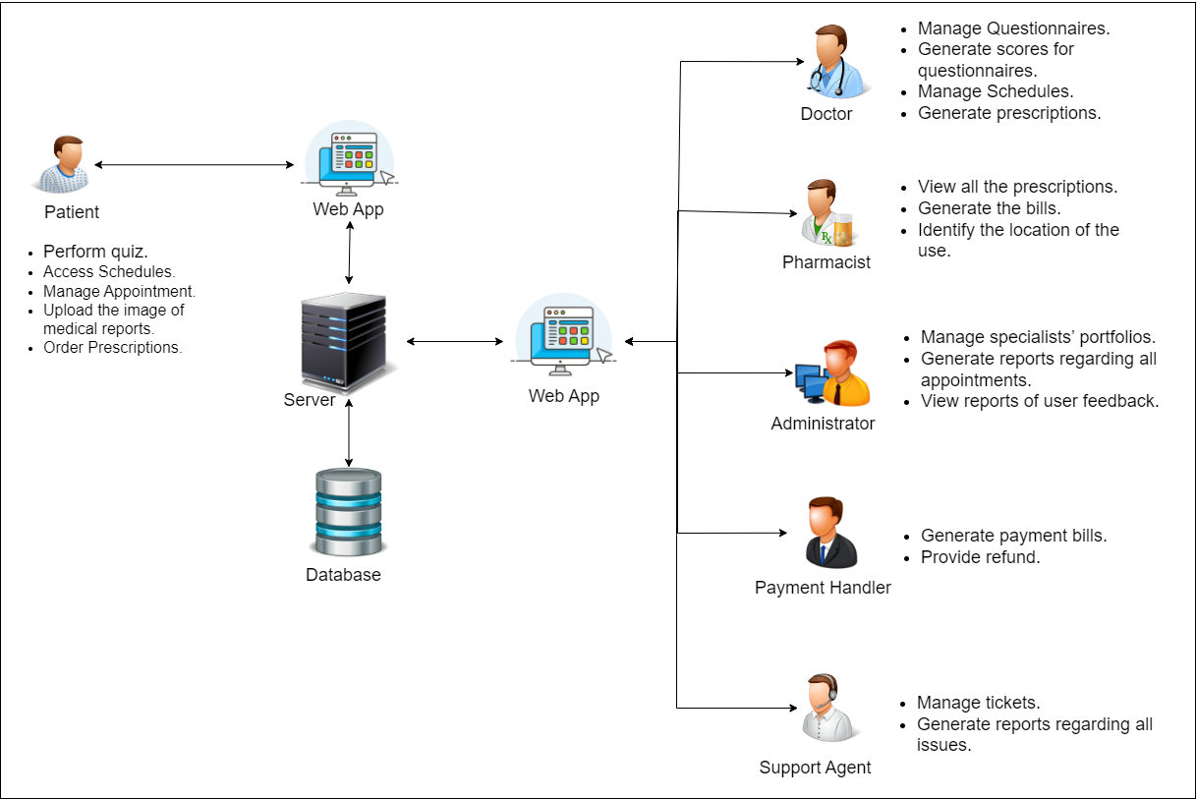
System Overview

Slide 7

Literature Review
Diverse treatment modes
Motivate Patients
Online Report Analysis
Consultations

Slide 8



Methodology
Requirements
Gathering
System Design
Implementation
Testing
Maintenance
Client-side
Server-side
Database

Slide 9
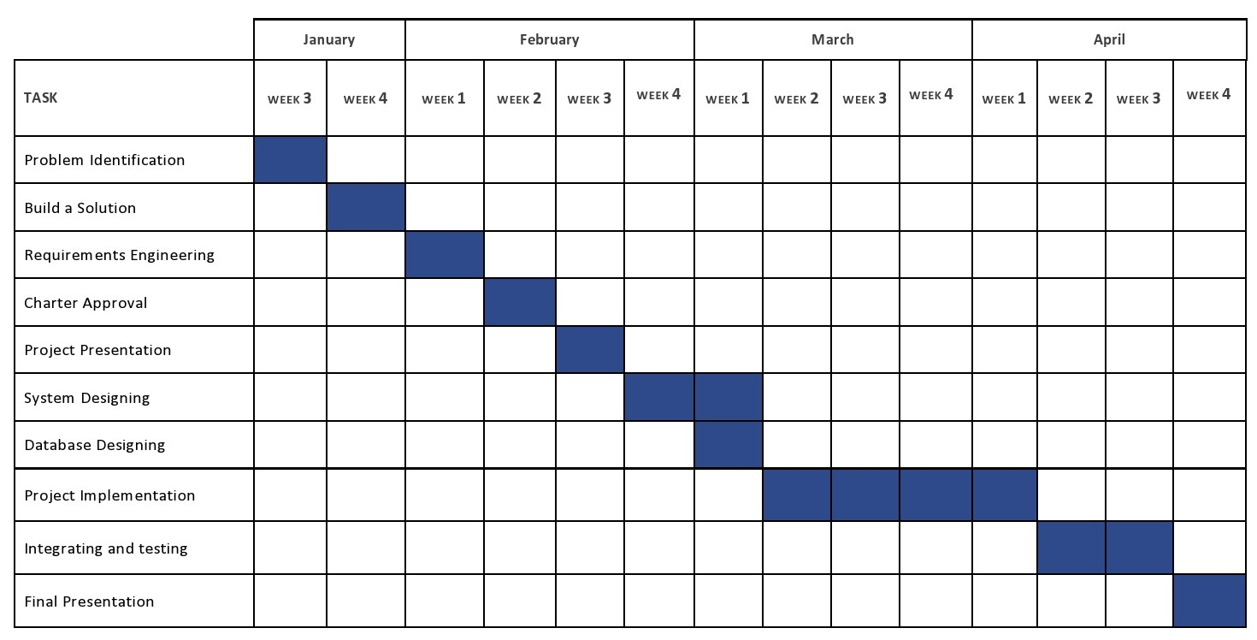
Gantt Chart

Slide 10
Work Breakdown Structure
Quiz Management
Schedule Management and Feedback Management
Progress Management
Appointment Management
Portfolio Management and Report Analysis
Pharmaceutical Management
Payment Management
Communication Management

Slide 11
01.
Quiz Management
IT21347962 - Siribaddana K

Slide 12
Quiz Management
Generate questions according to the category
Different points for each answer
Calculate risk level
Suggest schedules or appointments according to the results
IT21347962 - Siribaddana K

Slide 13
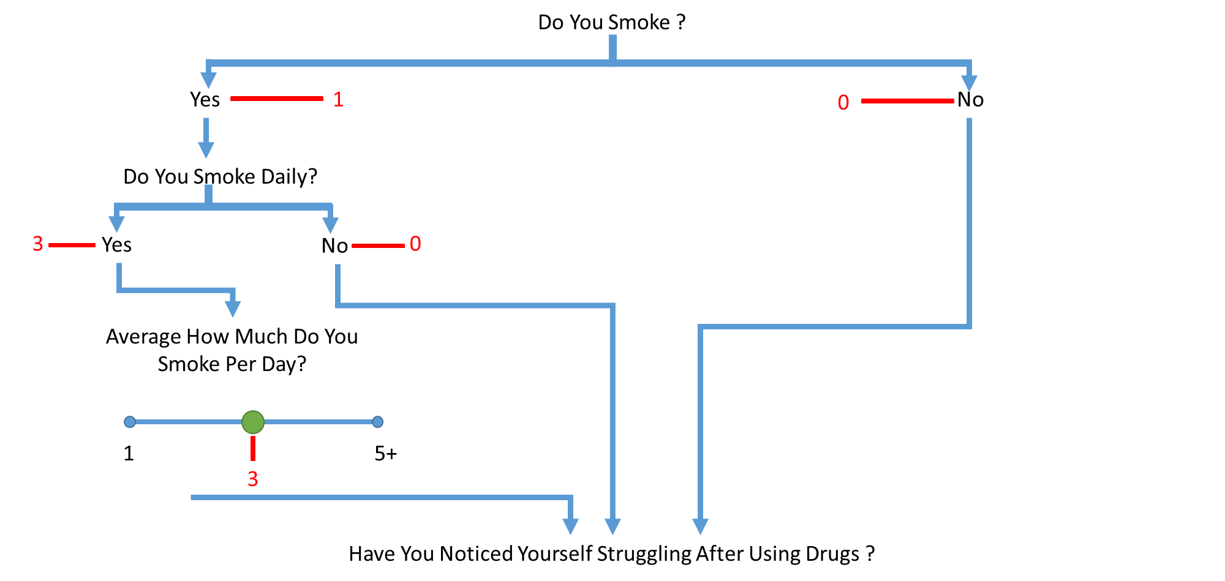
IT21347962 - Siribaddana K

Slide 14
Non-Functional Requirements
Protect user’s privacy
Give a count of question answered
Give more reliable questions
Technical Requirements
Front-End - ReactJS
Back-End - NodeJS and ExpressJS
Database - Mongo DB
IT21347962 - Siribaddana K

Slide 15
Schedule Management
and Feedback Management
02.
IT21321504 - Gunawardana N.B.C.A.W

Slide 16
Schedule Management and Feedback Management
Automating schedule creation
A schedule is offered based on quiz results
User feedbacks are collected and analysed to improve effectiveness
Provide reports based on user reviews
IT21321504 - Gunawardana N.B.C.A.W

Slide 17
Non-functional requirements
Accuracy
User friendly
Easy to navigate
Availability and reliability
Security
IT21321504 - Gunawardana N.B.C.A.W

Slide 18



Technical requirement
Internet Connection
Device
Server
IT21321504 - Gunawardana N.B.C.A.W

Slide 19
03.
Progress Management
IT21313684 - Karunarathne D.T.S

Slide 20
Progress Management
Set and edit goal.
View progress bar.
Search goal.
Set Reminder.
Generate Reports
IT21313684 - Karunarathne D.T.S

Slide 21
Non-Functional requirement
User friendly
Usability
Accuracy
Technical requirements
TWILIO API
IT21313684 - Karunarathne D.T.S

Slide 22
04.
Appointment Management
IT21319174 - Dissanayake M.G.T.W

Slide 23
Appointment Management
Set appointment
Rate doctor
Notify payment management
Generate Reports
IT21319174 - Dissanayake M.G.T.W

Slide 24
Non-Functional Requirements
Technical Requirements
Availability
Security
Accuracy
Scalability
Device
Internet Connection
Server
IT21319174 - Dissanayake M.G.T.W

Slide 25
05.
Portfolio Management
and
Report Analysis
IT21318320 - Silva T.U.D

Slide 26
Portfolio Management
Manipulate Details
Manage Specialists Details
Generate Reports
IT21318320 - Silva T.U.D

Slide 27
Non - Functional Requirements
Technical Requirements
Accuracy
Security
Efficiency
Internet Connection
Device
IT21318320 - Silva T.U.D

Slide 28
Report Analysis
01.Upload medical report
02.Analyze medical report
03.Receive Prescriptions
IT21318320 - Silva T.U.D

Slide 29
Non - Functional Requirements
Technical Requirements
Accuracy
Security
Efficiency
Internet Connection
Device
Server
IT21318320 - Silva T.U.D

Slide 30
06.
Pharmaceutical Management
IT21276996 - Fernando W.Y.M

Slide 31
Pharmaceutical Management
Log and Review the orders
Checks availability and notify user and supplier
Generating reports
Update Inventory
Location Detecting
IT21276996 - Fernando W.Y.M

Slide 32

Non Functional Requirements
Security
Reliability
Usability
Technical Requirements
Internet Connection
Device
IT21276996 - Fernando W.Y.M

Slide 33
07.
Payment Management
IT21200724 - Bandara G.N

Slide 34
Payment Management
Handle User Payments
When User cancels an appointment ,give a refund
Calculate shipping Cost
IT21200724 - Bandara G.N

Slide 35
Functional Requirements
Allow to generate shipping cost
Allow to Request a refund
Patient should receive a payment configuration document
IT21200724 - Bandara G.N

Slide 36
Non Functional Requirements
Technical Requirements
Security
User friendly
Availability
Google API
Database- MongoDB
Backend-Node Js and Express Js
Frontend-React JS
IT21200724 - Bandara G.N

Slide 37
08.
Communication Management
IT21319242 - Ilangarathne R.A.C.W

Slide 38
Communication Management
Handle and solve user inquiries
Track the progress of resolving patients’ issues using the id
Administrator will get access to view and generate reports regarding statistics of solved problems
Analyze tickets
Analyze reports
IT21319242 - Ilangarathne R.A.C.W

Slide 39
Functional Requirements
Login
Update tickets’ response
Create a report to solve unsolved problems
Take action on the issue
Notify the user who has an issue
IT21319242 - Ilangarathne R.A.C.W

Slide 40
Non-Functional Requirements
Technical Requirements
Agent Availability
Usability
Accuracy
Security
End-to-end encryption conversation
Web-based
Connecting to database - MongoDB
IT21319242 - Ilangarathne R.A.C.W

Slide 41
Thank You!

